Slide 1

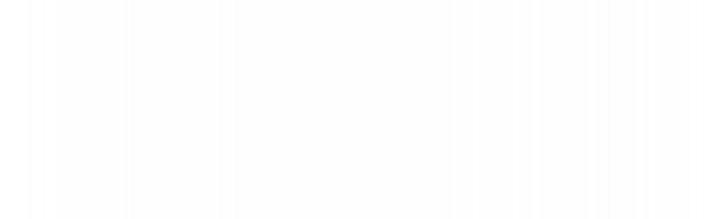

UNIVERSITY INSTITUTE OF ENGINEERING
COMPUTER SCIENCE ENGINEERING
Bachelor of Engineering
Design and Analysis of Algorithms(CST-311/ITT-311)
Topic: Branch and Bound method, 0/1
Knapsack problem
DISCOVER . LEARN . EMPOWER

Slide 2
Learning Objectives & Outcomes
Objective:
To understand the concept Branch and Bound method, 0/1 Knapsack problem
Outcome:
Student will understand
Branch and Bound method
0/1 Knapsack problem

Slide 3
Branch and Bound method
Branch and bound is an algorithm design paradigm which is generally used for solving combinatorial optimization problems. These problems are typically exponential in terms of time complexity and may require exploring all possible permutations in worst case.
It refers to all state space search methods in which all children of the E-node are generated before any other live node can become the E-node.
It consists of a systematic enumeration of all candidate solutions where large subset of fruitless candidates are discarded by using the upper and lower quantity being optimized.

Slide 4
Branch and Bound method (Contd.)
The method was first proposed by A. H. Land and A. G. Doig in 1960 for linear programming.
Goal: To find the minimum value of a given function f(x).
The Branch and Bound solution is the best suited method when item weights are not integers.

Slide 5
Tools required
Branching: Splitting the problem, given a set S of candidates, return 2 or more smaller sets S1,S2,….. whose union covers S.
Bounding: It computes upper and lower bound for each node and check whether this bound will be able to give the solution or not. By this calculation we are able to select which path we have to go and explore.

Slide 6
Applications of Branch and Bound
Traveling Salesperson Problem
0/1 Knapsack Problem
Nearest Neighbor Search
False noise analysis

Slide 7
0/1 Knapsack problem
How to find bound for every node for 0/1 Knapsack?
The idea is to use the fact that the Greedy approach provides the best solution for Fractional Knapsack problem.
To check if a particular node can give us a better solution or not, we compute the optimal solution (through the node) using Greedy approach. If the solution computed by Greedy approach itself is more than the best so far, then we can’t get a better solution through the node.

Slide 8
Complete Algorithm
Sort all items in decreasing order of ratio of value per unit weight so that an upper bound can be computed using Greedy Approach.
Initialize maximum profit, maxProfit = 0
Create an empty queue, Q.
Create a dummy node of decision tree and enqueue it to Q. Profit and weight of dummy node are 0.
Do following while Q is not empty.
  Extract an item from Q. Let the extracted item be u.
  Compute profit of next level node. If the profit is more than maxProfit, then update maxProfit.
  Compute bound of next level node. If bound is more than maxProfit, then add next level node to Q.
  Consider the case when next level node is not considered as part of solution and add a node to queue with level as next, but weight and profit without considering next level nodes.

Slide 9
REFERENCES
Text books:
Cormen, Leiserson, Rivest, Stein, “Introduction to Algorithms”, Prentice Hall of India, 3rd edition 2012. problem, Graph coloring.
Websites:
https://www.geeksforgeeks.org/implementation-of-0-1-knapsack-using-branch-and-bound/

Slide 10
Summary
Branch and Bound:
  Branch and Bound method
  0/1 Knapsack problem

Slide 11
THANK YOU

